Slide 1
Year 7
Week 5
Lesson 1
You will need your notebooks out only
Please rule them up

Slide 2


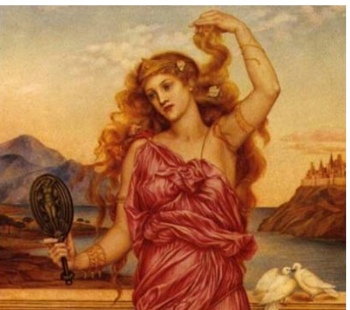
Lets Get Thinking….. What do all of these have in common?

Slide 3
Lets Get Thinking….. What do all of these have in common?
Hint….. Radiation, heat, beauty

Slide 4
All Units of Measurement!
Banana Equivalent Dose (BED) is an informal expression of radiation exposure due to naturally occurring radioactive isotopes by eating one average-sized banana
Scoville -this unit measures the hotness of a chili pepper
Helen of troy had a "face that launched a thousand ships” measures quantities of beauty in terms of the action that could be accomplished

Slide 5
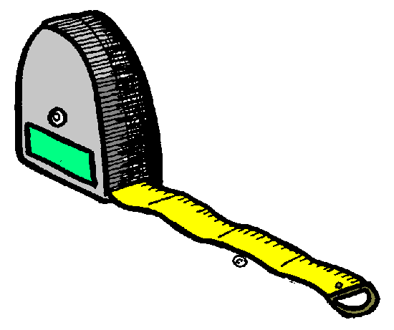
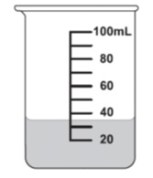
Measurement
Interactive Notebook
Name
Class
Teacher
Term 1 Semester 1
1

Slide 6
Contents
Glossary or Formula Page
Page
Date
Description
2
3

Slide 7
Tasks
24
7
30
Essential Question
Questions
Notes
Summary
4
5

Slide 8
24
7
30
Date
Title
EQ –
5

Slide 9
24
7
30
Date
Measurement Introduction
EQ – How can we convert between types of measurement?
Units
What does a gram measure?
Measures mass or how much something weighs
What does a litre measure?
Measures volume which is used when measuring liquids
What does a metre measure?
Measures length or distance
5

Slide 10
24
7
30
Date
Measurement Introduction
EQ – How can we convert between units of measurement?
Prefix + Base Units
3 most common:
Kilo
Centi
Milli
(example: Kilo-meter and kilo-litre)
5

Slide 11
24
7
30
Date
Measurement Introduction
EQ – How can we convert between units of measurement?
Metric Conversion Staircase
To convert to a smaller unit, move decimal point to the right or multiply
KILO
HECTO
DECA
BASE UNIT
DECI
CENTI
MILLI
Each step is either 10 times larger or 10 times smaller
To convert to a smaller unit, move decimal point to the right or multiply
5

Slide 12
24
7
30
Date
Measurement Introduction
EQ – How can we convert between units of measurement?
10 mm = ? cm
Am I moving up or down the stairs?
How many places?
Which way do I move the decimal?
Up
One
Left
10 mm = 1.0 cm
5

Slide 13
Task
1000 mg = _______ g
1 L = _______ mL
14 km = _______ m
160 cm = _______ mm
109 g = _______ kg
250 m = _______ km

Slide 14
24
7
30
Date
Measurement Introduction
EQ – How can we convert between units of measurement?
What I we measured from the school to your house?
Lets say you lived 16,000 m away from school. How could we make that number easier to manage?
Why is conversion important?
Metre →Kilometer – move up the ladder 3 places, and move the decimal place 3 places to the left
16 km
5

Slide 15
Word Problem
Example: Coach Kelly brought 32 L of water to the footy game, she divided the water equally between 8 coolers.
How many milliliters of water did Coach Kelly put into each cooler?

Slide 16
Exit Card Activity
1. In the top left corner please rate how you feel about conversions. (1 being not so good, 5 being really comfortable)
2. Create a word problem in which you need to convert units of measurement. Write this on your notecard with your name on it.
3. Once finished please share with your neighbor and try to solve.
You will be turning these in as you leave the room!

Slide 17
Homework
Review your notes and write a summary answering the essential question.

Slide 18
Notes Review
24, 7 ,30
Date
Title
Essential question
Notes complete
Notes complete with colour and diagrams
Questions completed
Contents page filled in
Formula page filled in

